Slide 1

The Battle of Neighborhoods (Week 2)
Bradu denis

Slide 2
Business Problem
For the final project, I chose to analyze the venues from the city I live in, Chisinau and compare them to other 2 major cities from nearby area, its sister-cities Iasi (Romania) & Odessa (Ukraine). Besides, I made also an analysis of the wards of these cities.
In this project, I’ve addressed the following questions:
Which are the most venue types for these cities?
How are they distributed among the wards?
How are they segmented base on the similarity of the most common F&B venues?
Is feasible to choose a common venue type from one of the analyzed cities to be deployed in another city of interest?
Would the algorithm recommend by itself this type of venue by itself?
What is the optimal number of grouped wards to make a proper venue analysis?

Slide 3
Who would be interested?
Start-ups who want to open a new restaurant.
Investors who want to look into F&B business.
City planners/ F&B Managers who need an overview on F&B venues distribution.

Slide 4
Data
In this project I used the following data source:
I collected all neighborhood/sectors data from various data sources, but mostly on Wikipedia.
Location (latitude/longitude) of each ward: using Geocoder on each ward location.
FourSquare API to generate nearby venues for each location. Which represent venues in that ward area. I used the special category ID for F&B venue.
K-means Clustering were used to cluster all F&B venue base on its category. Each cluster is then analyzed for location recommendation.

Slide 5
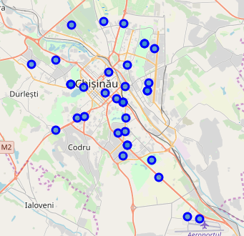
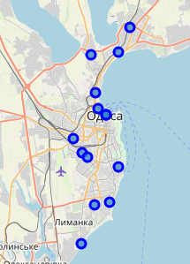
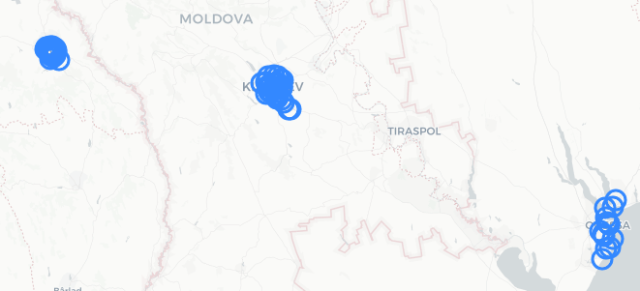
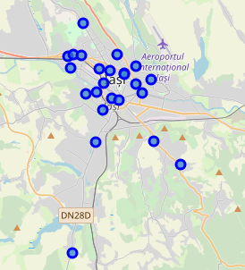
Wards & cities view
I visualized the location of wards within the city & a birds eye view of them

Slide 6
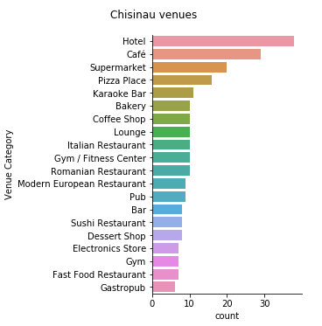
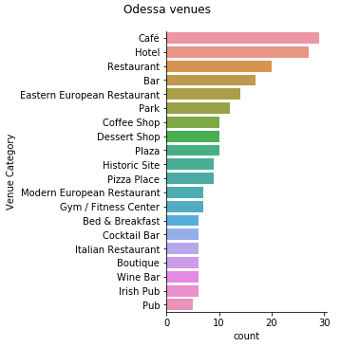
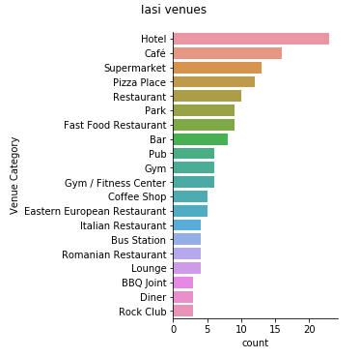
Venue data
The 20 most common F&B venues:

Slide 7
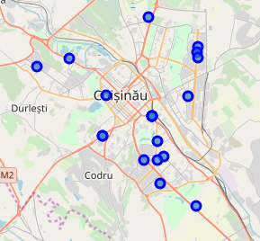
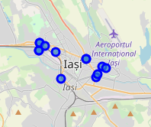
Venue of interest filtering
In Chisinau and Iasi, it is the same - supermarket, while in Odessa it isn't present even in top 20 venues.
This is an indicator of a business opportunity in the city.
I explored this fact more detailed and focused on potential deployment of a supermarket chain in Odessa.

Slide 8
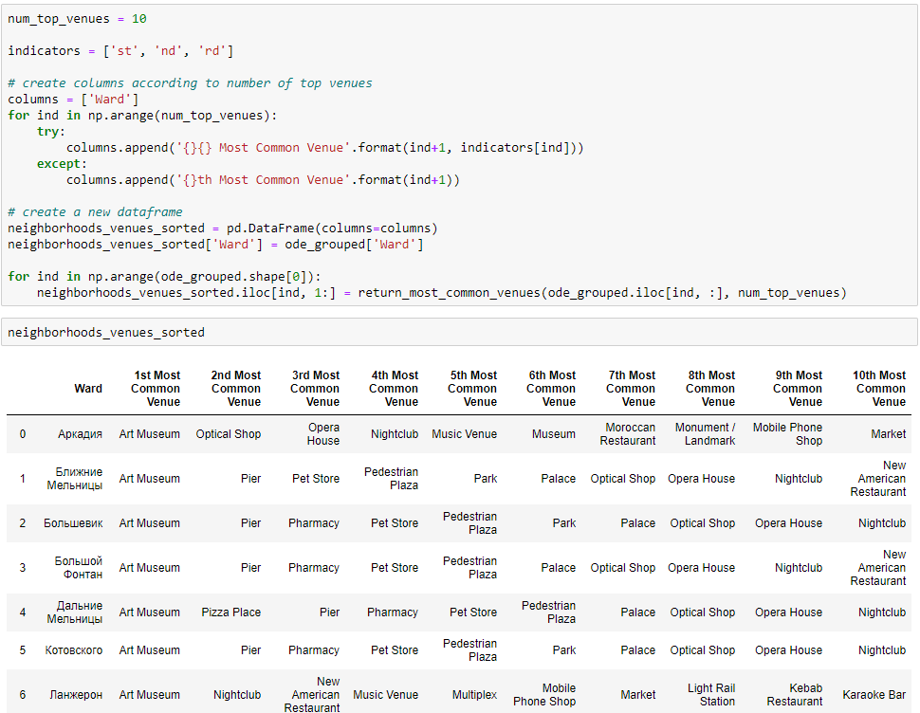
Venue ‘Supermarket’, Odessa case
Unfortunately, supermarket venue isn't found in the ones recommended by the function.
A workaround would be to make a lookup of venues types from Chisinau or Iasi with the ones from Odessa, then to make a recommending function based on the result.

Slide 9
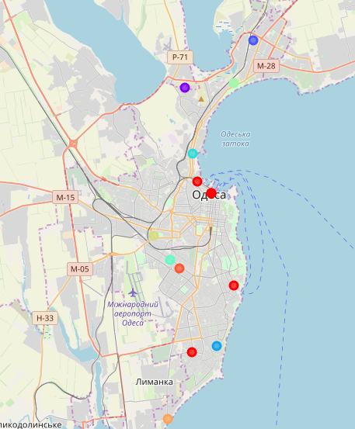
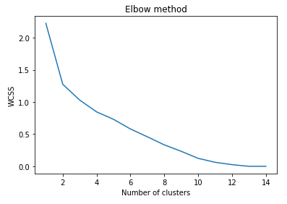
Re-cluster wards, Odessa!
Run k-means to check optimal cluster number to be used for Odessa based on WCSS method. In our data, there were tottally 15 wards.

Slide 10
Conclusion
Although the Foursquare data is still limited to a certain level, the location analysis gave me an overview on how F&B venues are distributed among the 3 cities.
Beside venues segmentation, this analysis can also be used for insights on specific type of venues that are planned to be opened.
Despite some drawbacks and room for improvement as mentioned, some of the result suit the real-life observation.
I hope this will be valuable for all those who are interested in F&B venues, and as an example of applied data science in actual problems.

